Slide 1
Impact of COVID-19 on vulnerable groups (youth)
Raphael Obonyo
The Youth Congress
Kenya, Africa

Slide 2

The Youth Congress
The real youth agent

Slide 3
COVID-19 in Africa
“Although the number of COVID-19 cases in Africa is quite low compared to other regions, the true extent of the pandemic’s impact remains unclear”

Slide 4
Youth and COVID-19
Reports By:
International Labour Organizations
The Youth Congress
“ The pandemic has had impacts on jobs, livelihoods, education, rights and mental well-being.”
“The impact of the pandemic on young people to be systematic, deep and disproportionate. It has been particularly hard on young women, younger youth and youth in lower-income countries.”

Slide 5
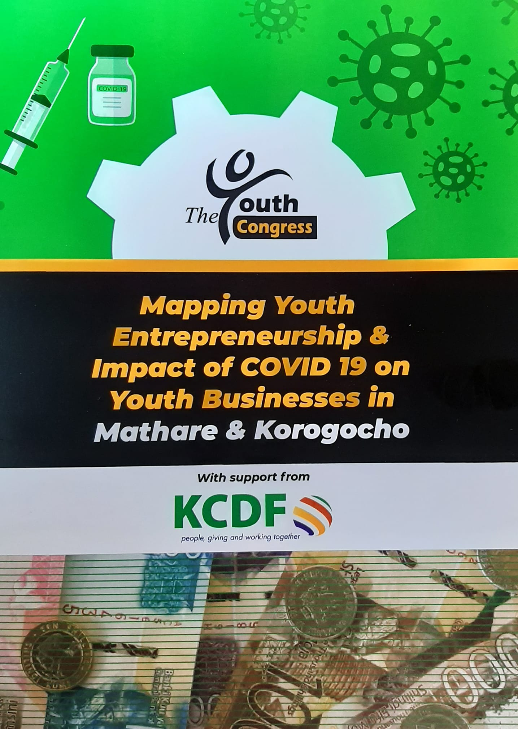
Impact of COVID-19 on youth livelihoods
“COVID-19 pandemic has had huge negative impact on youth businesses and livelihoods.”

Slide 6
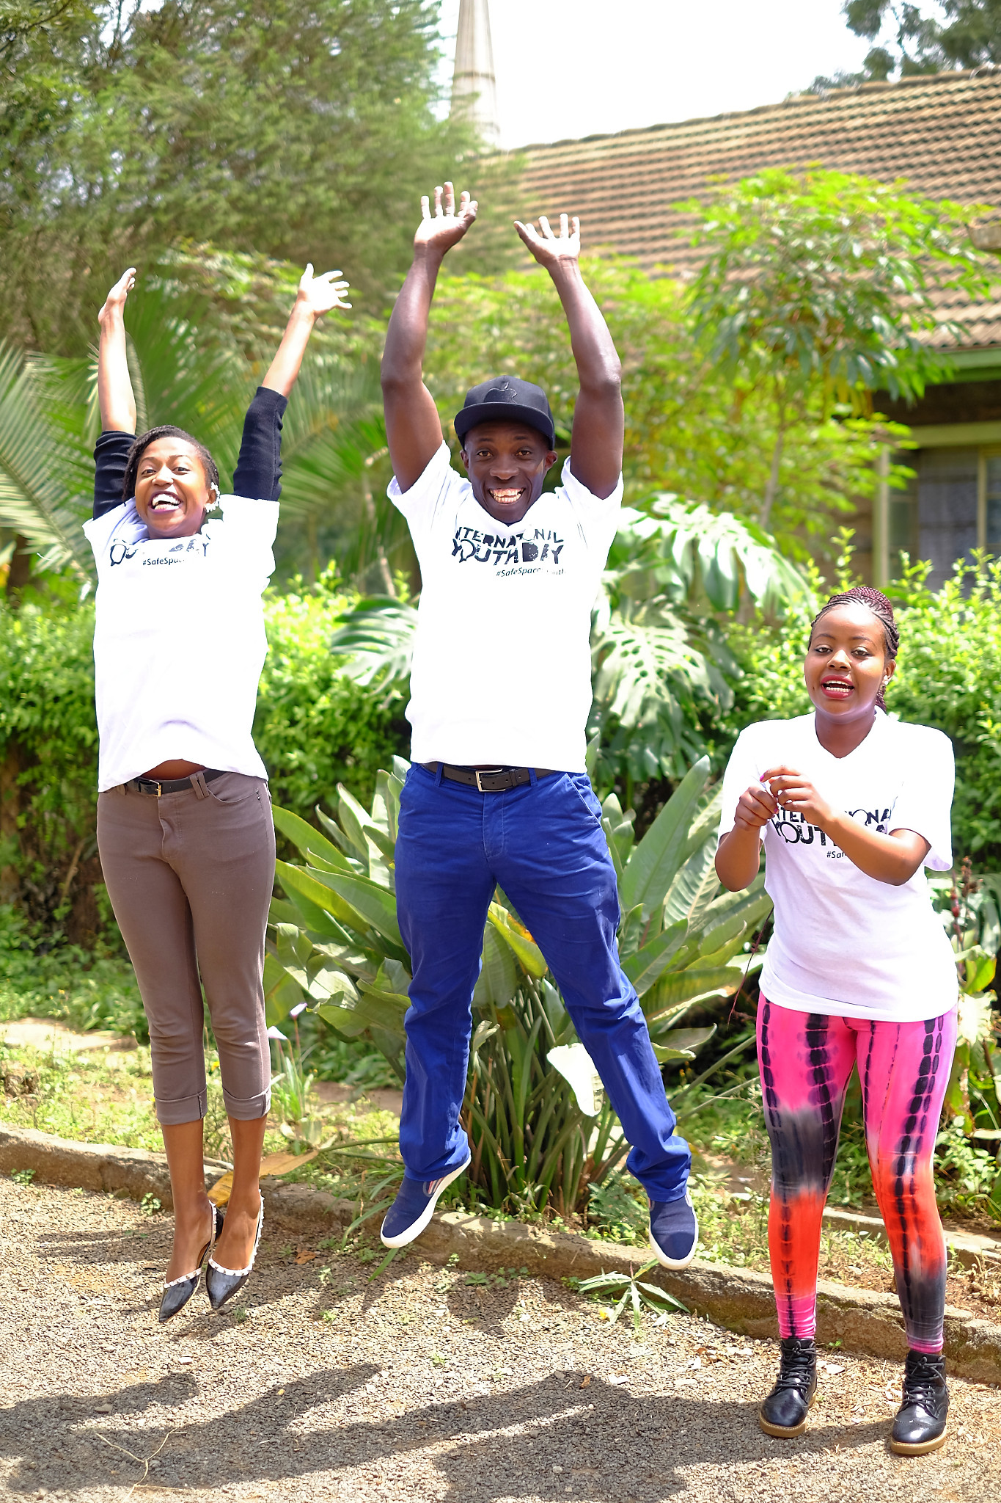
Call for Action
“Every effort must be made to support youth to build back better”

Slide 7
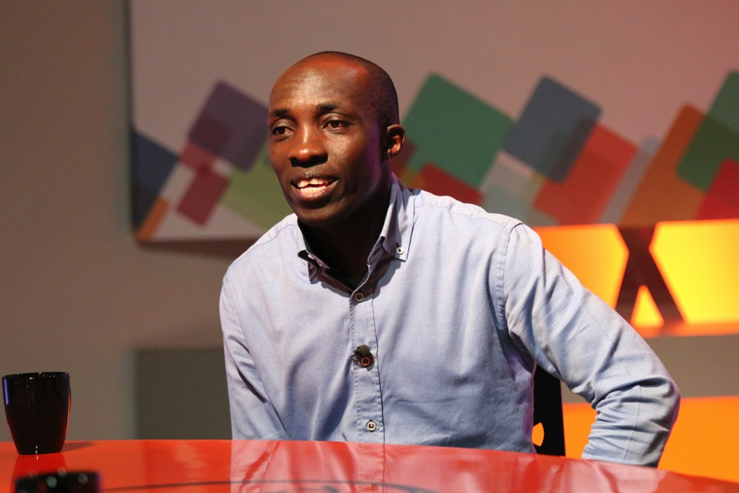
Thank You
FaceBook: Raphael Obonyo
Twitter: @RaphaelObonyo
Email: raphojuma@hotmail.com
www.theyouthcongress.org

